Slide 1
Client Server Architecture
EN.600.444/644
Spring 2019
Dr. Seth James Nielson

Slide 2
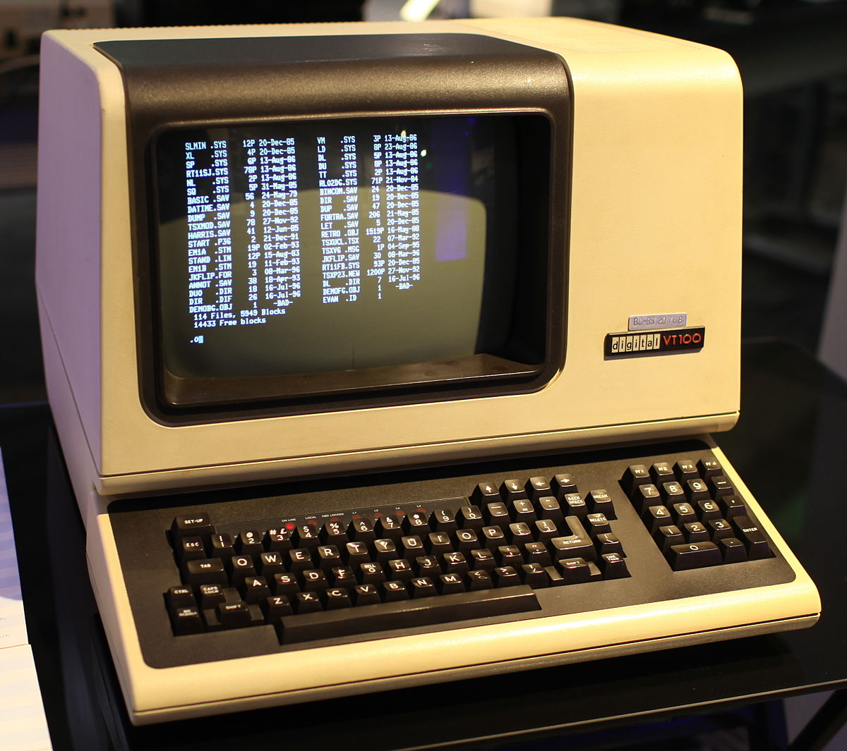

Computing 1960-1980 (ish)
NETWORK
This Photo by Unknown Author is licensed under CC BY-SA-NC
“DUMB” TERMINAL
MAINFRAME
This Photo by Unknown Author is licensed under CC BY-SA

Slide 3
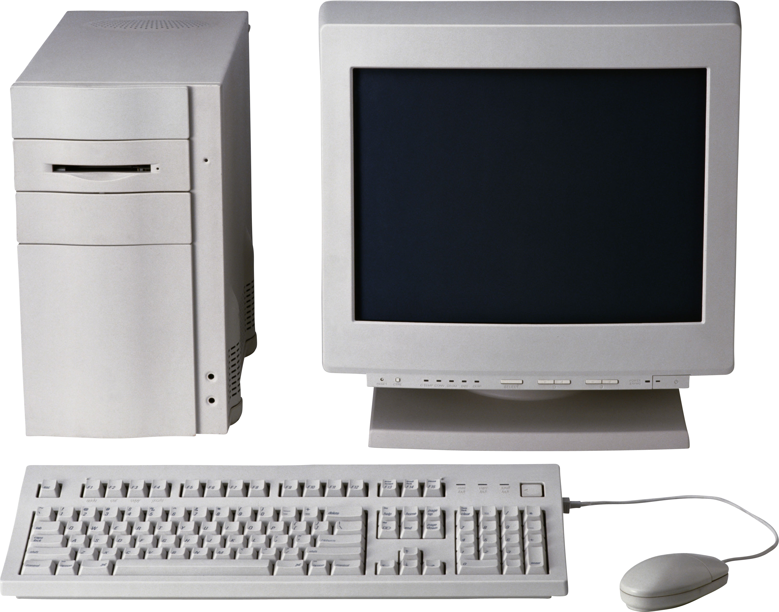
Computing 1980-2000 (ish)
This Photo by Unknown Author is licensed under CC BY-NC

Slide 4
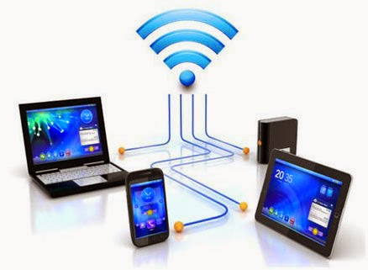

Computing 2000 – Present
NETWORK
This Photo by Unknown Author is licensed under CC BY
This Photo by Unknown Author is licensed under CC BY-NC-ND

Slide 5
General Ideas Behind Client-server
Put a bunch of resources in a high-performance, centralized machine
Clients can be much “dumber” by comparison
Much more efficient
Sharing data between devices, applications, and people (and marketing)
Access from multiple locations (including hackers!)
Time-sharing a central machine is more scalable and cost-effective

Slide 6

Server Abstraction
I’m Lonely. I wish someone would talk to me!
This Photo by Unknown Author is licensed under CC BY-SA
SERVER LISTENS FOR INCOMING REQUESTS

Slide 7

Preview of TCP/IP
Now I have an Address/Port! Maybe I’ll get Requests!
IP: 192.168.0.1
PORT: 80
This Photo by Unknown Author is licensed under CC BY-NC
This Photo by Unknown Author is licensed under CC BY-SA
SERVER HAS AN IP ADDRESS AND TCP PORT

Slide 8

Meanwhile, Client AbsTAction
HELLO?!
This Photo by Unknown Author is licensed under CC BY-NC
CLIENT CONNECTS TO MAKE OUTBOUND REQUESTS

Slide 9

TCP/IP Again
HELLO?!
TO: 192.168.0.1:80
FROM: 192.168.0.2:5280
Usually random
This Photo by Unknown Author is licensed under CC BY-NC
This Photo by Unknown Author is licensed under CC BY-NC
CLIENT CONNECTS TO MAKE OUTBOUND REQUESTS

Slide 10
Incoming Request
I GOT A REQUEST!!!
REQUEST
TO: 192.168.0.1:80
FROM: 192.168.0.2:5280
This Photo by Unknown Author is licensed under CC BY-SA
SERVER RECEIVES REQUEST

Slide 11
Request Response
MY NEW PENPAL!
RESPONSE
TO: 192.168.0.2:5280 FROM: 192.168.0.1:80
This Photo by Unknown Author is licensed under CC BY-SA
SERVER INVERTS TO/FROM FOR RESPONSE

Slide 12
Server Listens to Many Requests
SERVER USES (SRC IP, SRC PORT, DST IP, DST PORT)* TO MULTIPLEX
This is how one server on one port (e.g., webserver) handles many clients

Slide 13
Sockets
Sockets are a simple abstraction of client-server
Thus, there is a “client” socket and “server” socket
The server socket listens for incoming connections
The client socket makes an outbound connection to server
The server accepts the incoming connection and spawns a connected socket

Slide 14
What is a Protocol?
A protocol is the set of rules that govern the interaction of two or more parties
In the context of networking, it defines how two nodes communicate
When a party can communicate
What a party can communicate, including message structure
How a party responds to received communications
Certain outcomes or results are guaranteed when the rules are followed

Slide 15
Overloaded Term
Actually, a protocol often refers to two separate things
FIRST, the rules/specification referred to on the previous slide
SECOND, the computer module that implements the rules

Slide 16
Common Contemporary Protocols
HTTP – HyperText Transfer Protocol
IP – Internet Protocol
SMTP – Simple Mail Transport Protocol

Slide 17
One Protocol is not Enough
There are too many rules for any one protocol to handle
Also, behavior/rules need to change for different hardware/goals
For example, consider HTTP
HTTP protocol shouldn’t need to worry about the IP protocol rules
HTTP definitely shouldn’t need to worry about Ethernet rules
And HTTP should work even after a switch from Ethernet to Wifi

Slide 18
Protocol Stacks
Object-oriented design has been around long before object-oriented programming
Modularity
Abstraction
Information hiding
Protocols are designed in an object-oriented fashion
Protocols are combined to solve more complex problems
Each protocol should focus on one purpose/goal (High Cohesion)
Different component protocols can be swapped (Low coupling)
We call a group of protocols that work together a protocol stack
In computer networking, a network protocol stack or a network stack

Slide 19
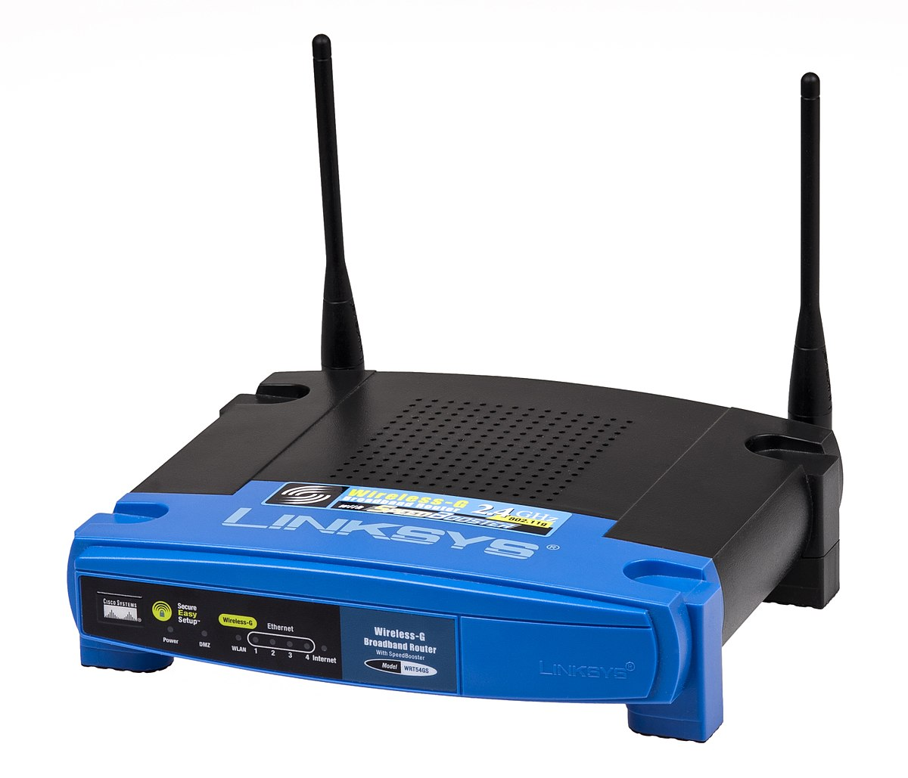

Monolithic vs Modular
HTTP Monolith Ethernet
HTTP Monolith
Wifi
HTTP
TCP
UDP
IP
Ethernet
WiFi
This Photo by Unknown Author is licensed under CC BY-SA
This Photo by Unknown Author is licensed under CC BY-SA

Slide 20
Other Problems with Monolithic
No separation of user/kernel space components
Code cannot be reused; code bloat
NxM combinations
Patching nightmare
Testing limitations
List goes on and on

Slide 21
OSI Model
Good object-oriented design is implementation independent
ISO defined a guide for any given network stack called the OSI Model
It has seven layers:
7: Application
6: Presentation
5: Session
4: Transport
3: Network
2: Data Link
1: Physical

Slide 22
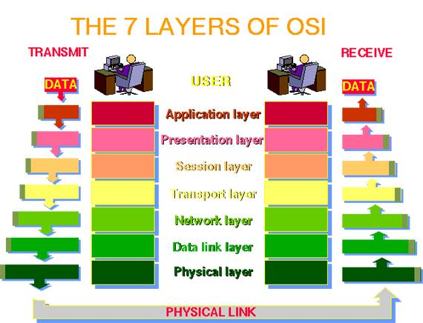

Slide 23
The OSI Model in Practice
Like most OO-designs, the abstraction often breaks down
Many stacks have multiple protocols in “one layer”, and none in another
Modularity/abstraction/information hiding break down
The TCP/IP stack really only uses the following layers:
Application (Layer 7; example: HTTP)
Transport (Layer 4; TCP)
IP (Layer 3; IP)
Data Link (Layer 2; example: Ethernet)
NOTE: It’s common to just refer to a layer by it’s number (e.g., a layer-4 protocol)

Slide 24
TCP/IP Stack
For our purposes, we will focus on TCP/IP and TCP/IP-like stacks
The TCP and IP layers are, obviously, fixed for layers 3 and 4.
But layers 7 and 2 vary widely
Millions of networked applications work over TCP/IP at layer 7
Many layer 2 protocols such as WiFi, Ethernet
Networked applications work over WiFi or Ethernet without any change
Sometimes called a MAC protocol (Media Access Protocol)
TCP/IP work over a walkie-talkie with an appropriate MAC protocol

Slide 25
How does Data Move in a Stack?
To send, data is inserted (pushed) at the top-most protocol
The receiving protocol
Processes the data, potentially splitting, recoding, etc
Derives one or more chunks of data
Typically affixes a header to each, but sometimes a footer and/or other meta-data
Each chunk, along with the meta-data is a “packet”
The packet is inserted (pushed) down to the next layer
When data is received, the process is reversed

Slide 26
TCP/IP Stack Example
HTTP Request
TCP
TCP
HTTP Request
IP
IP
TCP
HTTP Request
MAC
MAC
IP
TCP
HTTP Request

Slide 27
Division of Labor in TCP/IP
At the lowest layer, the MAC protocol simply connects two endpoints. Typically:
Has its own addressing scheme (MAC address)
Controls who talks when
Provides error detection and error correction
IP (Internetwork Protocol)
Connects many different networks of different media types
Global addressing scheme
TCP
Reliable, in-order delivery (Session)
Multiplexing

Slide 28
Interoperability
No one company writes all TCP modules; How do they work together?
Protocol specifications are approved by the IETF (Internet Engineering Task Force)
You can find the specifications in RFC’s (Request For Comments)
RFC 793 was the first specification of TCP (1981)
So long as an implementation follows the spec, it will be interoperable

Slide 29
RFC 793 Overview
Data broken into “segments” in section 2.2
Network layers in section 2.5 (a little different from our usage)
Section 2.6 lays out critical goal: Reliability
Data is delivered reliably (i.e., delivery is assured)
Data is delivered in-order
How? Sequence numbers and acknowledgements on segments
Section 2.7 identifies another goal: Multiplexing
Different flows get different ports
Section 2.8 indicates that this is a stream based protocol

Slide 30
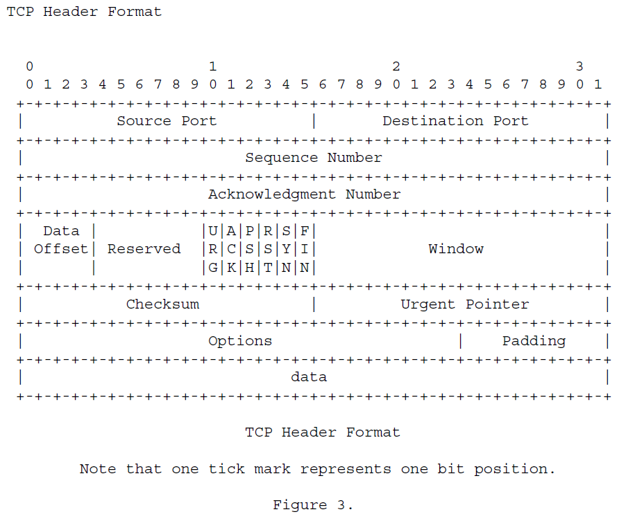

Slide 31
Protocols and State Machines
It is often useful to model a protocol as a finite state machine (FSM)
The protocol starts in an initial state
When it receives data, it processes the data and moves to a new state
For TCP, a state machine is defined in section 3.2
If you don’t know what a FSM is, or how it works, you should probably look it up

Slide 32
Playground Networking
In Playground, we also have a network stack:
Application Layer (e.g., Escape Room, Bank)
Playground Wire Protocol (Layer2/3)
TPC/IP as our Mac Protocol
NOTE: This is important! TCP/IP, for our overlay network, is just a “wire”

Slide 33
Escape Room
(client)
Escape Room
(server)
Playground Wire Protocol
Playground Wire Protocol
TCP/IP “Wire”

Slide 34
Playground Networking Pt 2
Notice we don’t have a layer 4 (session)
Packets transmitted using the playground wire protocol are not connected together
It’s just luck (!!!!) that certain applications “appear” to work right
And, once we turn on packet loss, there’s no guarantee anymore!
You will DESIGN and IMPLEMENT a reliable transport protocol for Playground.

Slide 35
The Upcoming LaB1: Reliable Delivery
Escape Room
(client)
Escape Room
(server)
Class Transport Protocol
Class Transport Protocol
Playground Wire Protocol
Playground Wire Protocol
TCP/IP “Wire”

Slide 36
PRFC
Every group will create a PRFC to describe your protocol (Playground RFC)
It needs to define the protocol clearly enough that anyone in the class can implement it!
You will draft your PRFC as you create your protocol.
In creating the protocol, you need to define your packet structure.

Slide 37
REMEMBER THIS?

Slide 38
Packet Definition
WE ARE NOT GOING TO DEFINE PACKETS AT THE BIT/BYTE LEVEL
To make this easier, Playground provides a simple method for defining, creating, and processing packets
You start by defining a packet structure using the PacketType class
from playground.network.packet.fieldtypes import UINT32, STRING
from playground.network.packet import PacketType
class MyPacket(PacketType):
DEFINITION_IDENTIFIER = “netsec.20194.MyPacket”
DEFINITION_VERSION = “1.0”
FIELDS = [ (“src”, STRING),
(“port”, UINT32) ]

Slide 39

PacketType And PRFC
Do NOT put byte descriptions in your PRFC for your packet definitions
Instead, put in the playground packet type class definition!
from playground.network.packet.fieldtypes import UINT32, STRING
from playground.network.packet import PacketType
class MyPacket(PacketType):
DEFINITION_IDENTIFIER = “netsec.20191.MyPacket”
DEFINITION_VERSION = “1.0”
BODY = [ (“src”, STRING),
(“port”, UINT32) ]
This Photo by Unknown Author is licensed under CC BY-SA

Slide 40
The Packet Definitions Define a Standard
But they are also practical and useful:
packet = MyPacket()
packet.src = “20164.1.2.3”
packet.port = 80
transport.write(packet.__serialize__())

Slide 41
Deserializing Packets
def __init__(self):
self._buffer = MyPacket.Deserializer()
def recv(self, data):
self._buffer.update(data)
for pkt in self._buffer.nextPackets():
print(pkt.src)
print(pkt.port)

